Slide 1
Project On car portal
Name : Jatin Sain
Branch : CSE-2
Semester : 7th Sem
Year : 4th
Enrollment no : 01115007221

Slide 2
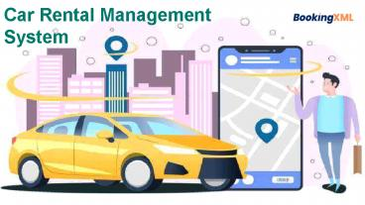
INTRODUCTION
It is an online system through which customers can view available cars, register, view profile and book car.
Nowadays, most of the people prefer car for their trip.
Because car journey to any trip with our family or friends or friends give happiness and makes us to feel comfortable.
Many advantages in car rental system rather than using own cars for their journey.

Slide 3
Admin module
Admin can create vehicle brand
Manage vehicle brand(Edit, Delete)
Post vehicle
Manage Booking (Admin can confirm and cancel booking)
Manage testimonials(Active and Inactive)
Manage to contact us query
Admin have the details of registered user
Admin can also update the page content
Admin can update the contact details
Manage subscribers

Slide 4
CONTINUE…
Admin Dashboard (admin can view the count of register user, total booking, total subscribers, total queries, etc.)
Change password (admin can change own password).
Logout.

Slide 5
User Module
Car booking
View car booking history
Update his/her profile
Update his/her password
Post testimonials
View testimonials
Logout

Slide 6
Requirement specification
Hardware requirements
Processor –Intel(R) Core(TM) i5-6300U
Ram – 8.00 GB
Hard disk – 20 GB
Software requirements
Operating system –window 11
Using IDE – VScode
User Interface design – HTML,CSS, JAVASCRIPT
Web browser – Google chrome

Slide 7
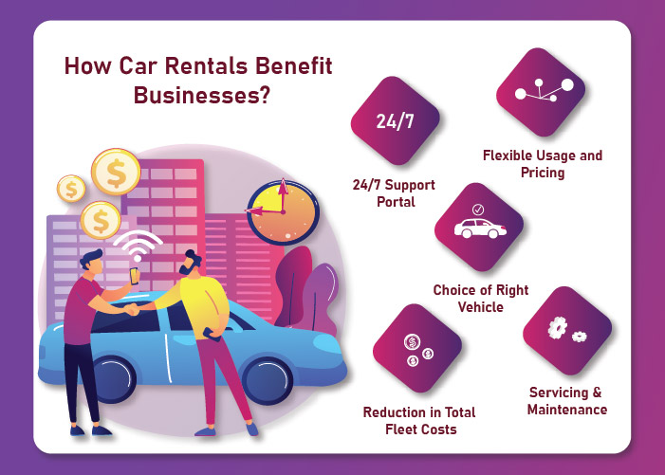

Slide 8
Advantage
This online car portal solution is fully functional and flexible.
This online car rental portal helps in back office administration by streamlining and standardizing the procedures.
Its saves a lot of time, money and labour.
Its provide custom feature development and support with software.
The software acts as an office that is open 24/7.

Slide 9
Disadvantages
If you run tours and activities in remote areas where you aren’t able to get on the Internet, online booking might not be for you Lack of interaction between the teacher and student.
You must return the vehicle to an acceptable state, according to the normal condition.
As India is not a fully developed country problem may arise like in rural areas where there is lack of computer knowledge or where computers are not yet discovered.
Hackers can easily manage to achive confidential data through fake online application, or website.

Slide 10
Feature scope
Automation of the entire system improves the efficiency.
It provides a friendly graphical user interface which proves to be better when compared to the existing system.
It gives appropriate access to the authorized users depending on their permissions.
It effectively overcomes the delay in communications.
Updating of information becomes so easier.
System security, data security and reliability are the striking features.
The system has adequate scope for modification in future if its necessary .

Slide 11
conclusion
The solution was to provide car rental with an user-friendly web application that would allow for customers to access and use on a wide range of devices, desktop, laptop, mobiles devices, tablets.
The website is designed to stay up to date by giving administrators the ability to change/add/remove any featured vehicles on the site.
The website will verify and store any information the user may input when making a rental purchase request.
This will appear in real life onto the software used by the employees.
This software provides an easy-to-use interface to allow for simple access to rental request and customer information.

Slide 12


